Slide 1

Trading risks
Markus Gesmann
Vario Global Capital Ltd.
EARL Conference, 14 September 2016

Slide 2
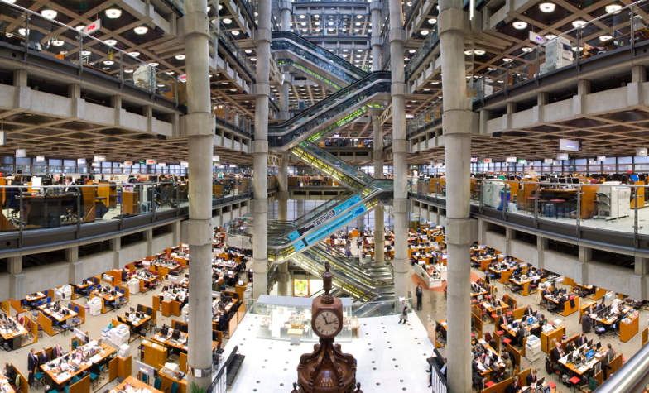
Abstract
Since the start of Lloyd's coffee house over 300 years ago risk trading has progressed from speculative gambling to sophisticated modelling of risks. This talk will give a brief overview of the ideas and tools used in the insurance space.
Source: Lloyd’s

Slide 3
What is the difference between gambling and insurance?

Slide 4
It’s a matter of perspective!
Insurance reduces risks.
Gambling introduces risk.

Slide 5
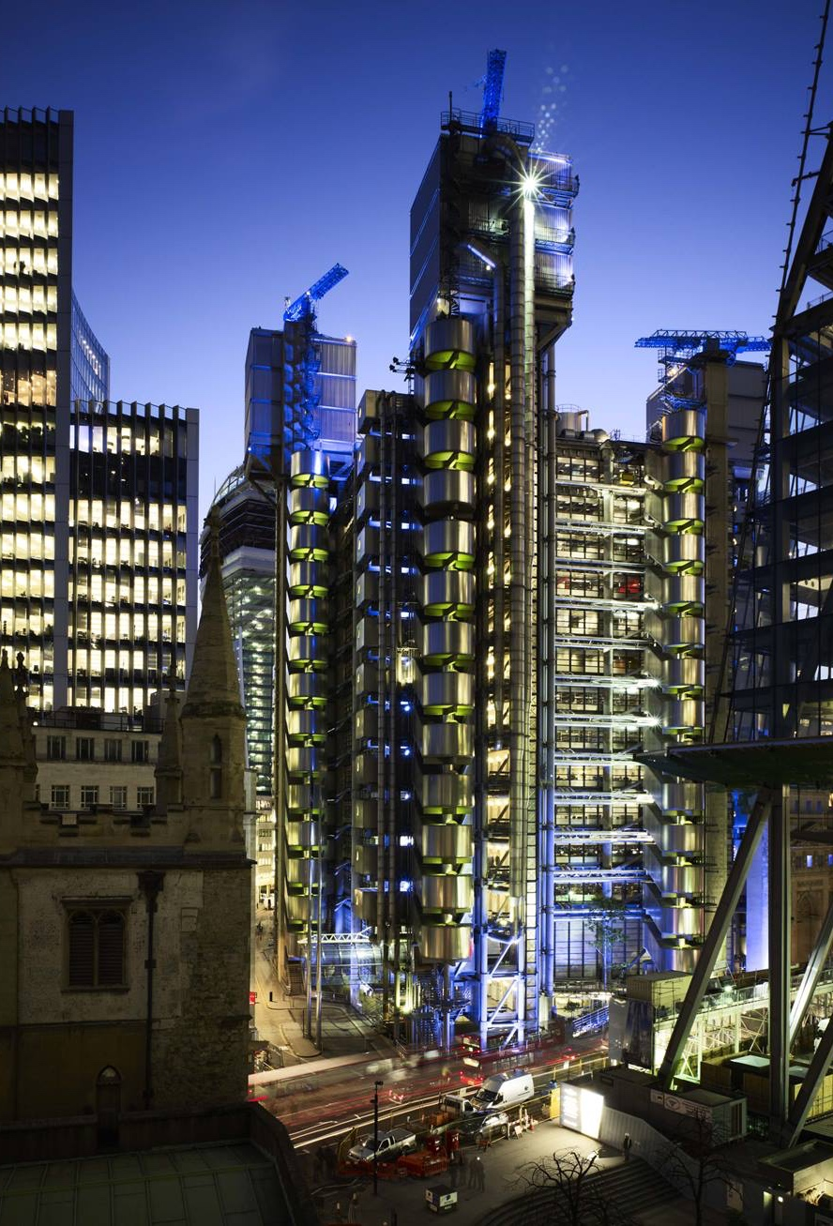
To achieve efficient Trading of Risks we have to bring insurers and gamblers (investors) around the same table.
Source: Lloyd’s

Slide 6
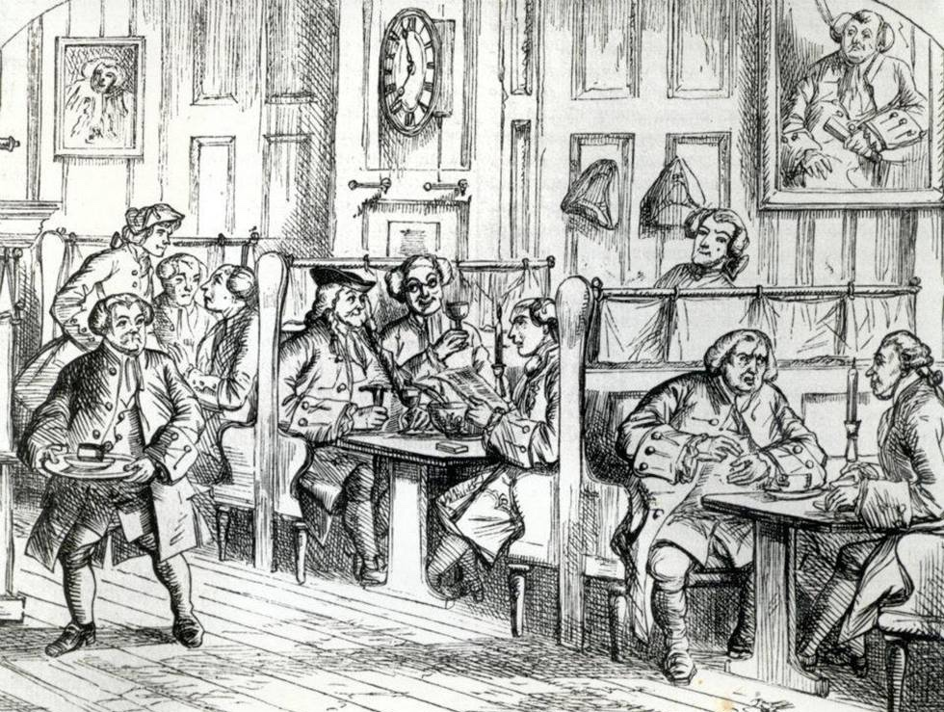
Meet Lloyd’s Coffee House
London is the trade centre of the world.
Legend has it that ship owners met at Lloyd’s coffee house in London, for coffee, and to exchange news and other pastime pleasures.
Source: Lloyd’s

Slide 7
Meet William.
He is a shipowner. His ship will sail around the world and is expected to return with goods in three years.
The Marquess Wellesley by John Philip Davis ("Pope" Davis).

Slide 8
Meet George.
He is rich. Very rich.
He has an appetite for some riskier investments in his portfolio.
Portrait of Richard Colley Wellesley, 1st Marquess Wellesley, Governor-General of India 1798-1805 (1760-1842)

Slide 9
William loses his capital, if his ship doesn’t return.
George looks for attractive investments.

Slide 10
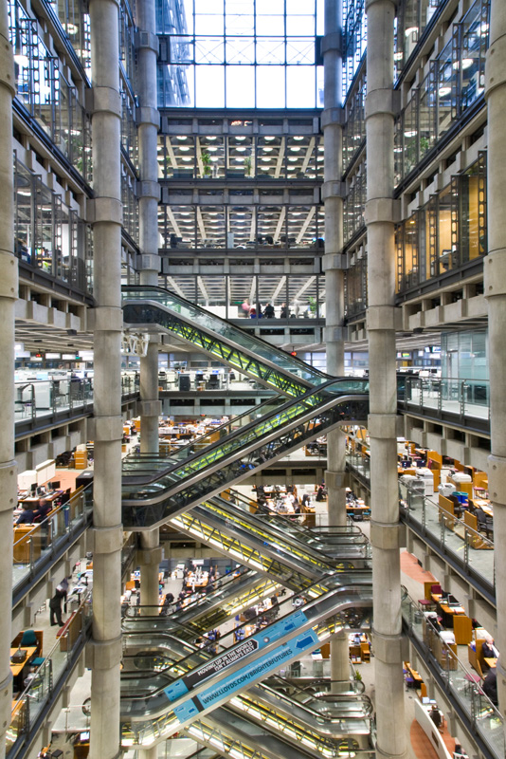
Insurance connects William and George.
George is willing to provide capital to underwriters to insure William's ship for a premium.
It is a win-win situation for all parties. Risk is traded.
Source: Lloyd’s

Slide 11
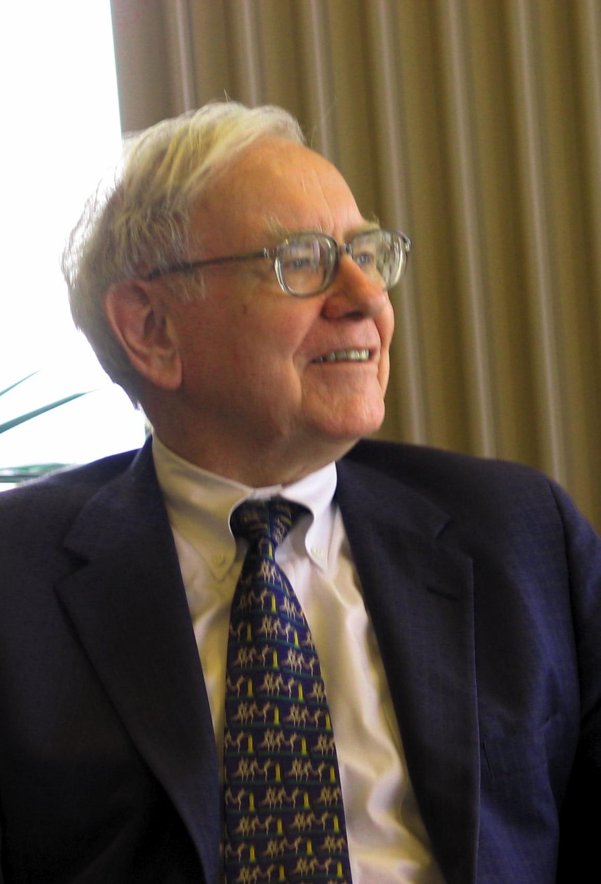
A simple transformation
Underwriters turn risks into investment opportunities.
Building a well diversified portfolio of risks can provide a very attractive asset class.
Warren Buffet. By Mark Hirschey (Work of Mark Hirschey) CC BY-SA 2.0, via Wikimedia Commons

Slide 12
But the old model is no longer working

Slide 13
The challenge
Insurers are carrying too much equity capital to generate attractive returns.
Fixed income markets are accepting historically low yields.
The old insurer investment model of using solely equity to capitalise the ‘float’ is no longer effective
Source: *US Federal Reserve, †Swiss Re Sigma 2016/3
Insurers and fixed income investors can derive mutual benefit through direct investment in insurance risk

Slide 14
Improve trading of risk
Required: Professional, transparent, regulated, diversified and commoditized

Slide 15
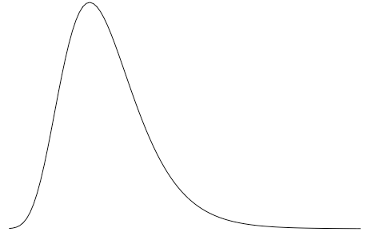
Insurance risk as an investment tower
‘AA’ equivalent
Capital Resources
‘A’ equivalent
‘BBB’ equivalent
Expected
Underwriting Result
Risk profile
Catastrophe Claims
Large Claims
Premiums & reserves
Attritional Claims
Expenses

Slide 16
R packages to asses the risk profile
actuar, fitdistrplus,
ChainLadder, coplua
evir
Capital Resources
Expected
Underwriting Result
mbbefd
Risk profile
Catastrophe Claims
Large Claims
Attritional Claims
Base R, e.g. glm, nlme
Expenses

Slide 17
The challenge
Thankfully, many loss events don’t happen that often.
There is often little data in insurance.
Fitting distribution is a challenge.
Charts show a sample of 50 lognormal random figures, refitted to a lognormal distribution.
Source: http://www.magesblog.com/2011/12/fitting-distributions-with-r.html

Slide 18
Combine expert judgment and data
BUGS/JAGS
LaplacesDemon
Stan
PyMC3
Recent years have seen new probabilistic programming languages

Slide 19
Benefits of a Bayesian approach
Consistent approach to incorporate expert judgment
Clarity about the model uncertainties
Output provides a full distribution and better understanding of risk
However, it is a more challenging approach

Slide 20
Better understanding of risk will lead to a transformation in the warehousing of risks
Historical Value Chain
Today
Future
Equity Investor
Equity Investor
Equity
Investor
Fixed Income Investor
Investor Type
Hedge Fund
Intermediary
Banks & Asset Managers
Banks & Asset Managers
Specialist Fund Manager
Insurance Risk
Insurance Risk
Insurance Risk
Insurance Asset
Opening up all of the insurance risk to fixed income investors brings industry capitalization into line with how other sectors are financed

Slide 21
Conclusions My liability is your asset
The old business model of generating ‘float’ and to live off the investment returns is no longer viable for insurance companies
Risk modelling provides the foundations for successful risk transfer
Like Lloyd’s, syndicating and trading the remote risk improves return on equity

Slide 22
Thank you
Markus Gesmann
Email: markus.gesmann@variopartners.com
Phone: +44 (0) 7981 006 152
This publication has been prepared for general guidance on matters of interest only and does not constitute professional advice. No representation or warranty (expressed or implied) is given as to the accuracy or completeness of the information contained in this publication. To the extent permitted by law, Vario Global Capital Ltd, its members, employees and agents do not accept or assume any liability, responsibility or duty of care for any consequences of you or anyone else acting in reliance on the information contained in this publication.
© 2016 Vario Global Capital Limited. All rights reserved.
Vario Global Capital Limited is a company registered in England & Wales with registered number 10033177.
Registered Office: One Fleet Place, London EC4M 7WS, United Kingdom.

